Slide 1
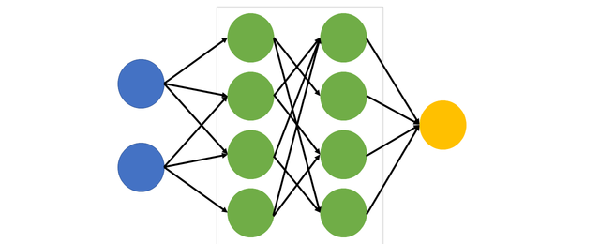
Deep Learning
Image Classification with CNN

Slide 2
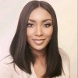
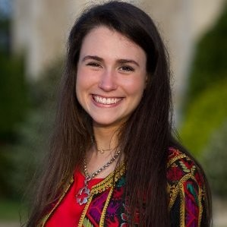
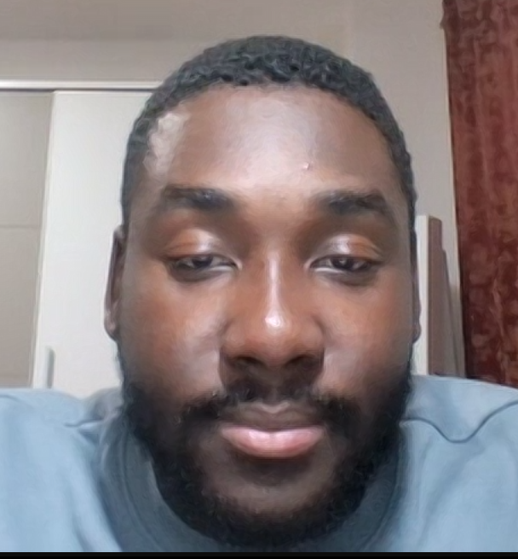
Meet the Team
Adeteju Enunwa
Priscilla Coghlan
Marvin Mends

Slide 3
Welcome!
https://ai.invideo.io/watch/hjD-mBGJSqT
‹#›

Slide 4
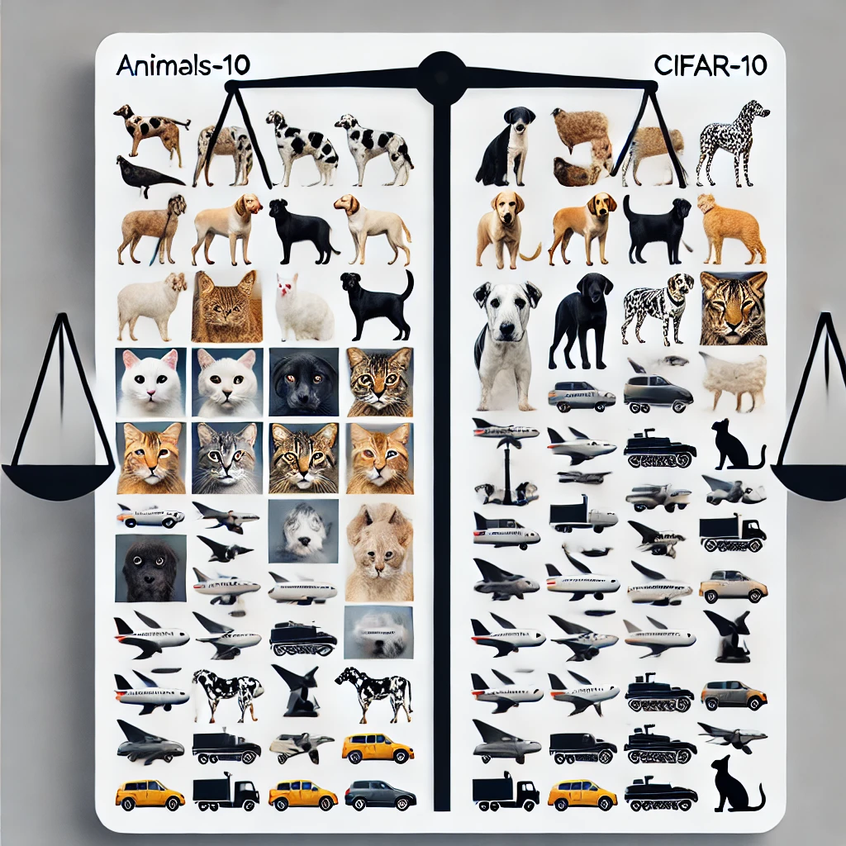
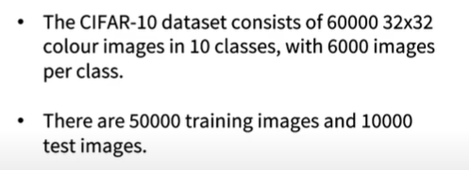
Dataset of Choice
Animals-10 | CIFAR -10
Focused on Animals: Contains only images of animals (e.g., cats, dogs, horses). Limited Scope: Good for specific animal-related tasks. | Diverse Object Categories: Airplanes, automobiles, birds, cats, ships, etc. Balanced Classes: 6,000 images per category, avoiding dataset biases. Versatile Applications: Useful for smart glasses for elderly drivers and autonomous driving by offering broad object detection capabilities. CIFAR-10’s variety helps the model generalize better for real-world tasks.

Slide 5
Problem Overview
Our Success Secret
Problem Statement : The What
Challenge : The Why
Solution : The How
CNN is ideal because:
Automatically learn and extract features
Efficiently handle complex visual data with minimal manual feature engineering.
The challenge stems from the dataset's diversity, requiring the model to recognize distinct patterns across varied and complex images.
Small image size (32x32 pixels)
Category similarities
Model complexity
Lemon drops oat cake oat cake sugar plum sweet pie oreo lava cake
Chocolate cake sweet pastry candy canes chocolate cake sesame pie
Oreo cake lollipop sweet lolypop

Slide 6
Data Pre-processing 1/2
1
2
3
Normalization
Data Augmentation
One-Hot Encoding
Random Flipping
Random Rotation
Random Zoom & Translation
Gaussian Noise
‹#›

Slide 7
Data Pre-processing 2/2
Data Augmentation Technique | Benefits to Our Model
Random Flip (50%) | This helps the model learn features regardless of the horizontal orientation of the objects in the image, which is useful for tasks like object recognition.
RandomRotation (10% rotation): | This helps it recognize objects even when they appear at different angles.
RandomZoom (10%) | simulates variations in object size due to distance from the camera, helping the model be robust to objects appearing larger or smaller than expected.
RandomTranslation (Image translation by 10%): | Helps the model generalize better by making it robust to slight positional changes in the object within the image.

Slide 8
SECTION ONE
CNN Architecture
Fully connected layers with a final softmax output for 10 classes.
Batch Normalization
Adam optimizer
3
Convolutional blocks with increasing filters (64 to 512)
2D
Max pooling
0.2 - 0.5
Dropout
1
Fully connected dense layer
‹#›

Slide 9
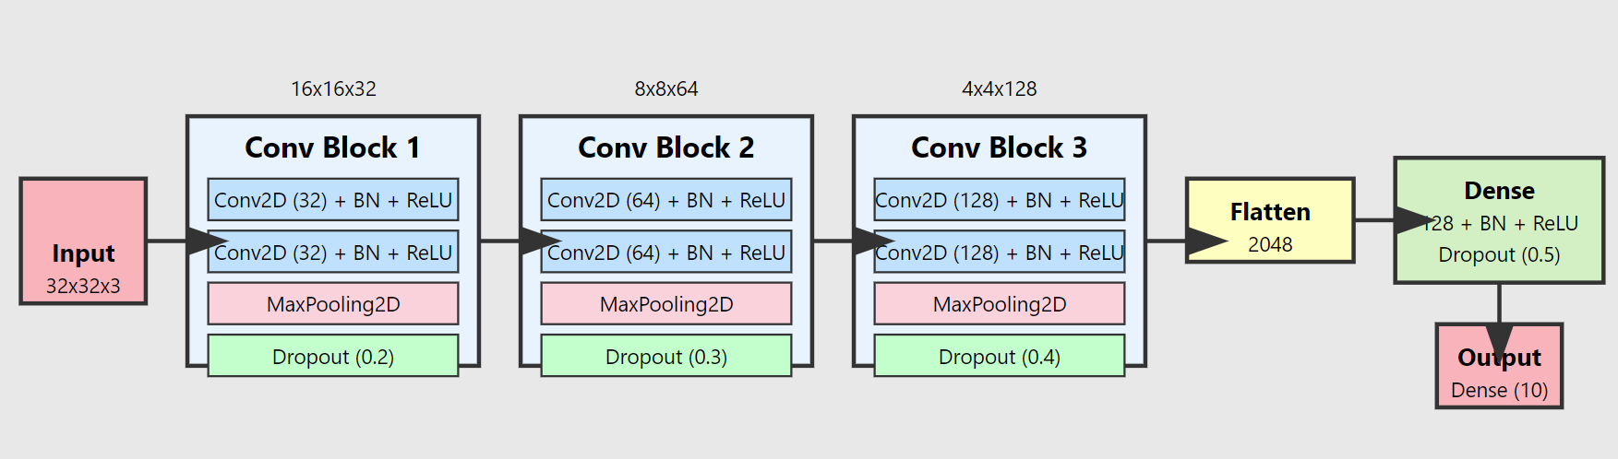
CNN Model Architecture
‹#›

Slide 10
Optimization Techniques
Adam
1
Regularization
Dropout & L2
2
LearningRate Scheduling & Callbacks
Early stopping, ReduceLROnPlateau
3
Batch Normalization
4
‹#›

Slide 11
Transfer Learning - VGG 16
VGG16 pre-trained on ImageNet captures low- and mid-level features (e.g., edges, textures) that are generalizable across different tasks.
Decision: Reuse to avoid training from scratch, allowing faster convergence with limited data (CIFAR-10).
1
2
Froze early layers (first 10) to retain general patterns while reducing computation.
Unfroze to fine-tune the last 10 layers to allow adaptation to the specific patterns of CIFAR-10, improving performance on the target dataset.
Add fully connected layers (256 & 128 units) with Batch Normalization and Dropout for better regularization and preventing overfitting.
Used augmentation (rotation, shifts, flips) to improve generalization and prevent overfitting.
Early stopping to prevent overfitting, and learning rate reduction to allow the model to settle into better minima.
3
Froze early Layers
4
Unfroze later layers
5
Added Fully connected layers
Data Augmentation
Training strategy
‹#›

Slide 12

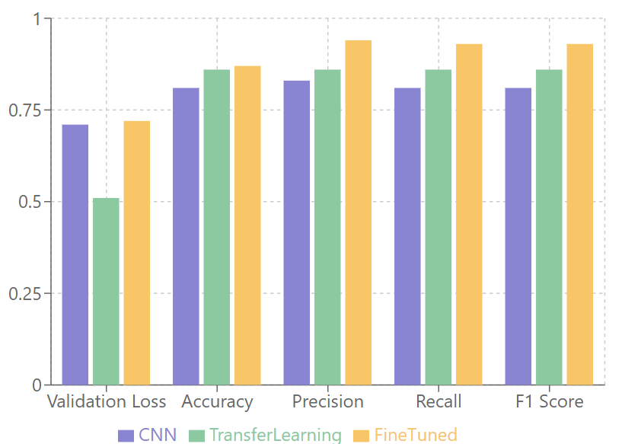
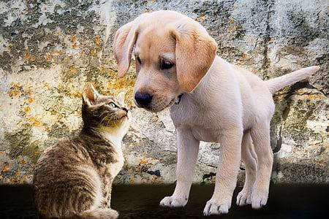
Evaluation 1/2

Slide 13
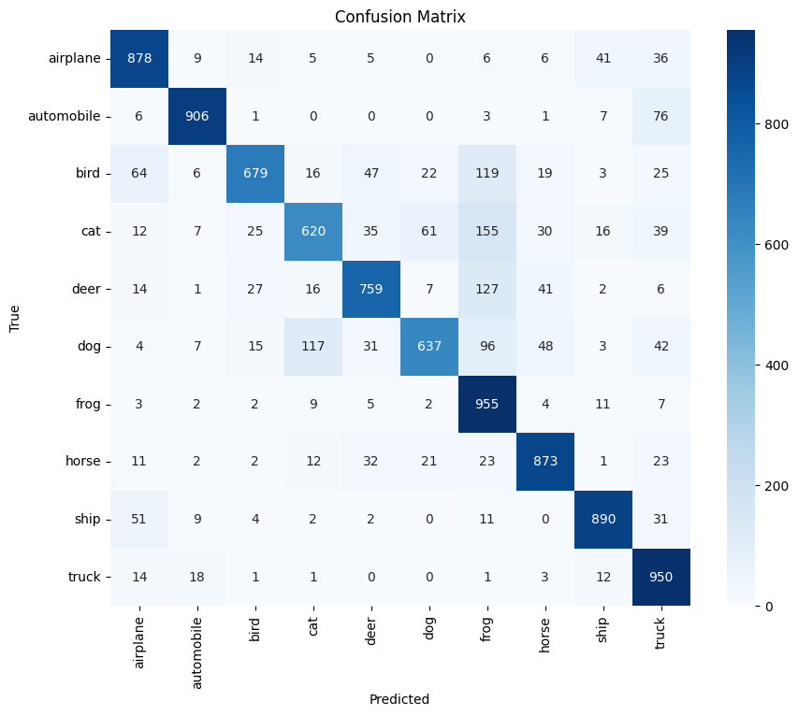
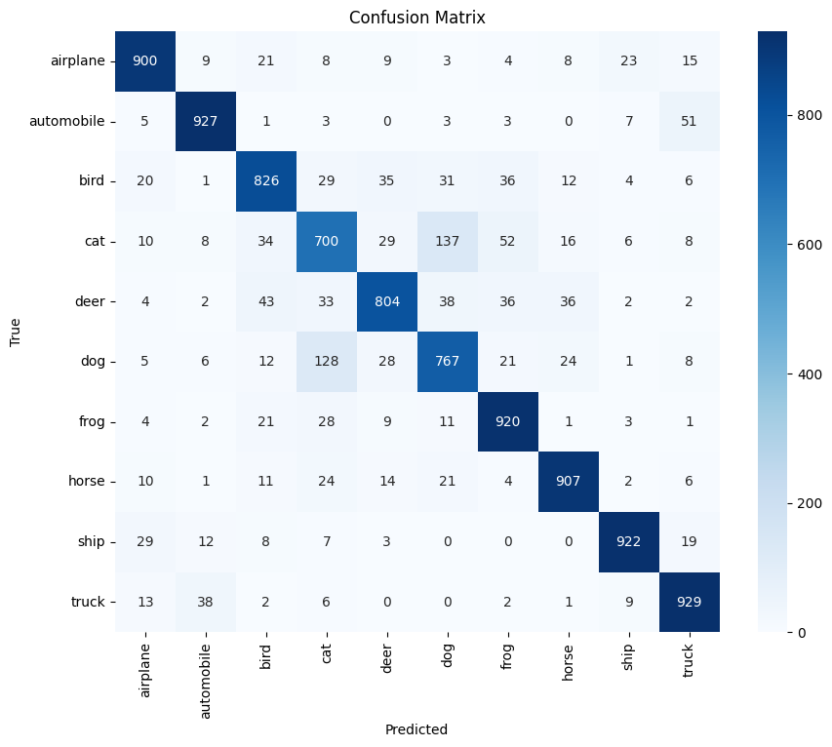
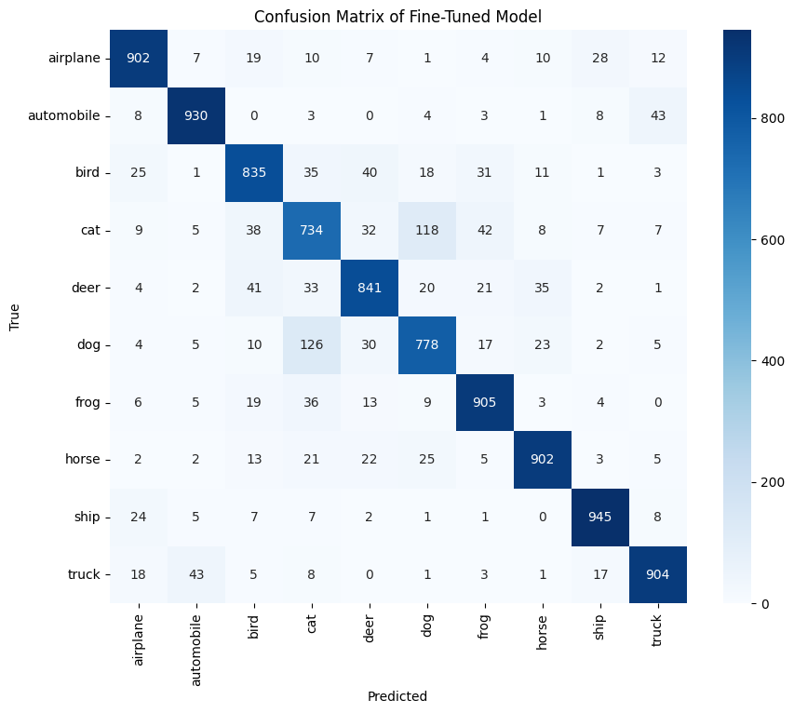
Confusion Matrices- Comparison
CNN Model
VGG 16 Transfer Learning
Fine-tuned

Slide 14
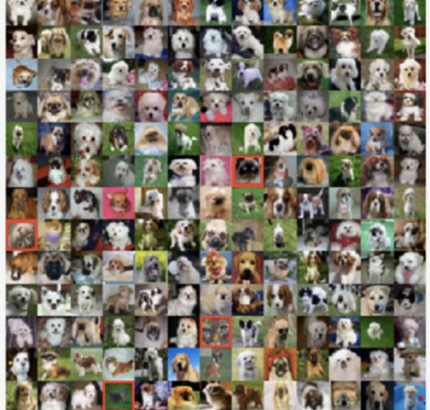
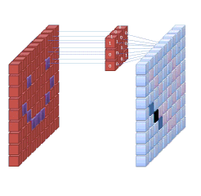
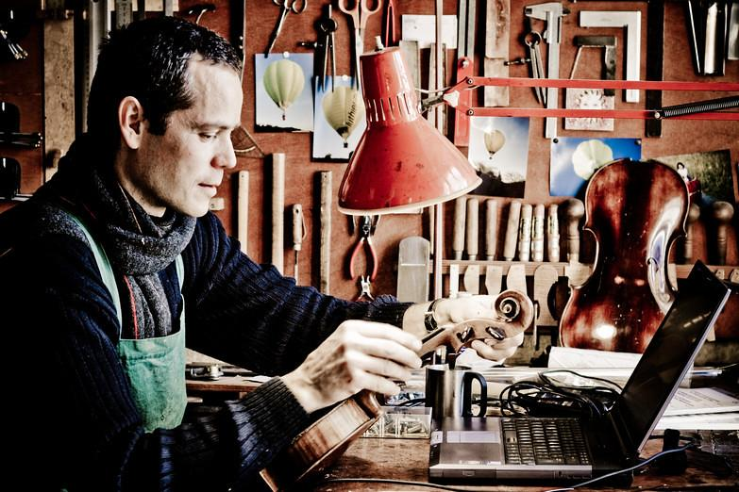

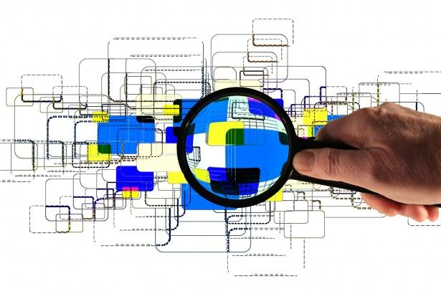
Freeze & unfreeze layers as necessary
Save your model
Loading & Pre-processing
Convert to binary and augment
Transfer Learning & Fine-tuning
Model Architecture
Leverage learning rate scheduler
Watch out for overfitting
Use checkpoints
Early stop please!!!
CiFAR- 10 Dataset
Consider the purpose of your model.
Future Work
Try out other models e.g. ResNet50, Efficient Net, or InceptionV3
Further Fine-Tuning
Advanced Data Augmentation
Lets Recap !

Slide 15


The model wasn't great at identifying me because i was here all along :)

